Slide 1
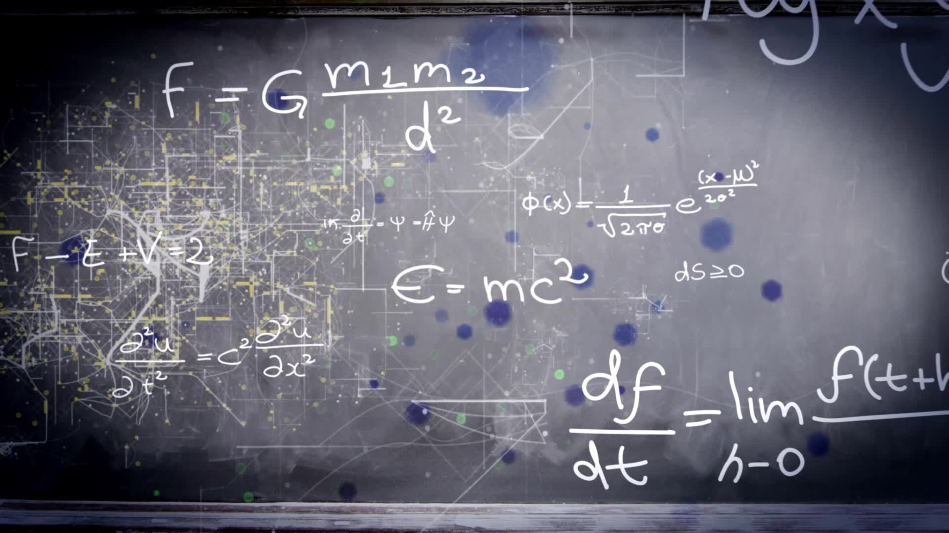
Computer Animation of Physics
Sunny Shree

Slide 2

Physics Simulation
Simulation, run on a single computer, or a network of computers, to reproduce behavior of a system
Utilizes mathematical equations with theoretical physics
Basically used as algorithms

Slide 3
Graffiti
Concept
Mathematics
Physics
JavaScript
Simulation
Html5 Canvas
Web Browser

Slide 4

Head start
Freefall of a ball in air and water
Oscillating motion
Elastic collision

Slide 5
Newton`s Second Law :The acceleration of an object as produced by a net force is directly proportional to the magnitude of the net force, in the same direction as the net force, and inversely proportional to the mass of the object.
Free Fall
Any object that is being acted upon only by the force of gravity is said to be in a state of free fall.
Buoyancy
Upward Force exerted by fluid on an object placed in it.
Drag Force
a force acting opposite to the relative motion of any object moving with respect to a surrounding fluid.

Slide 6
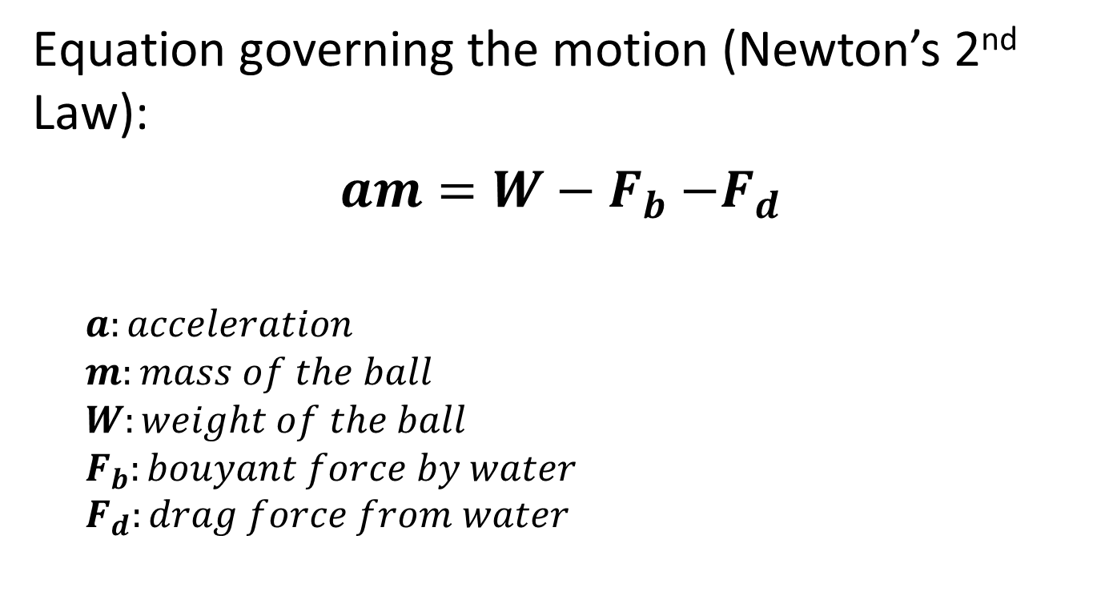
Object Falling in Air-Water
$\text{Equation} \text{governing} \text{the} \text{motion}$ (Newton’s 2nd Law):
$am=W−F_{b}$ ${−F}_{d}$
$$a:acceleration$$
$$m:mass of the ball$$
$$W:weight of the ball$$
$$F_{b}:bouyant force by water$$
$$F_{d}:drag force from water$$
Fb
Fd
W

Slide 7
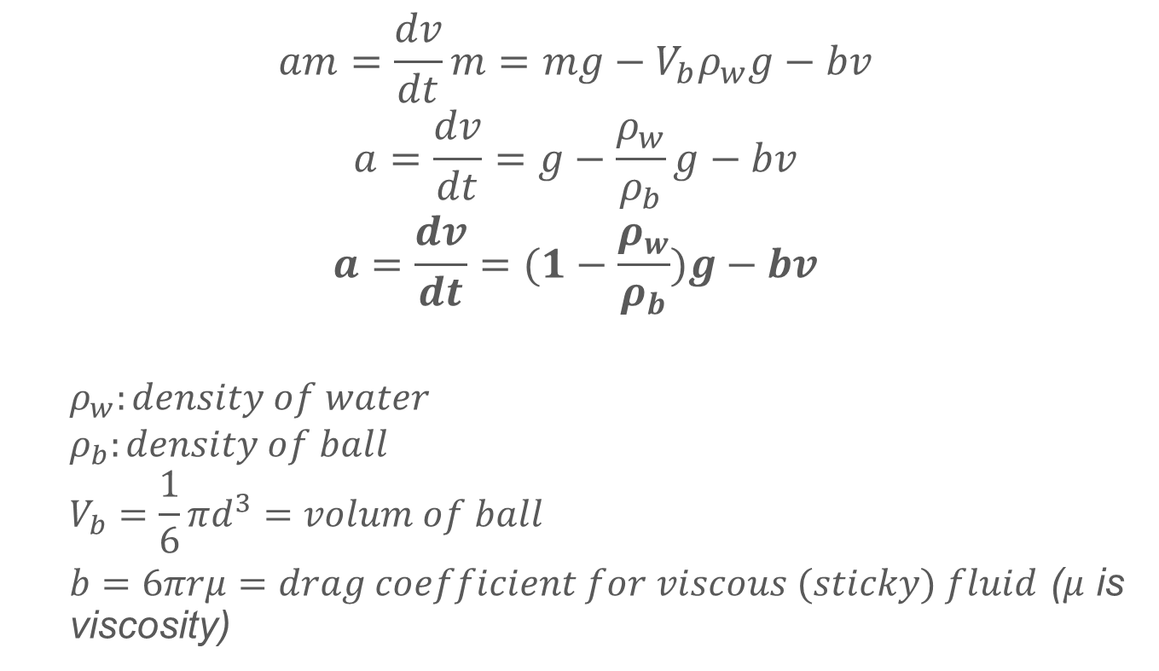
Governing Equation
$$am=\frac{dv}{dt}m=mg−V_{b}ρ_{w}g−bv$$
$$a=\frac{dv}{dt}=g−\frac{ρ_{w}}{ρ_{b}}g−bv$$
$$a=\frac{dv}{dt}=(1−\frac{ρ_{w}}{ρ_{b}})g−bv$$
$$ρ_{w}:density of water$$
$$ρ_{b}:density of ball$$
$$V_{b}=\frac{1}{6}πd^{3}=volum of ball$$
$b=6πrμ=drag coefficient for viscous (sticky) fluid$ ($μ$ is viscosity)

Slide 8
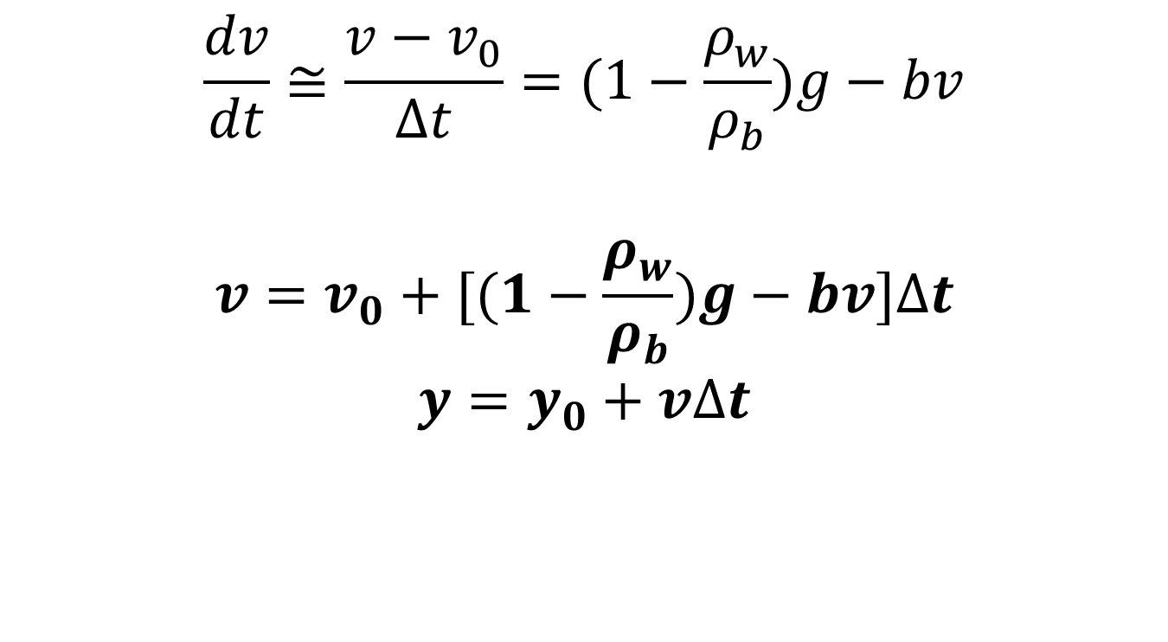
Numerical Approximation
$$\frac{dv}{dt}≅\frac{v−v_{0}}{∆t}=(1−\frac{ρ_{w}}{ρ_{b}})g−bv$$
$$v=v_{0}+[(1−\frac{ρ_{w}}{ρ_{b}})g−bv]∆t$$
$$y=y_{0}+v∆t$$

Slide 9
PartII
Potential Energy : energy possessed by an object by virtue of its position.
Kinetic Energy : energy possessed by an object by the virtue of its motion or movement.
Energy Conservation Theory : energy cannot be created or destroyed, but only changed from one form into another or transferred from one object to another.

Slide 10
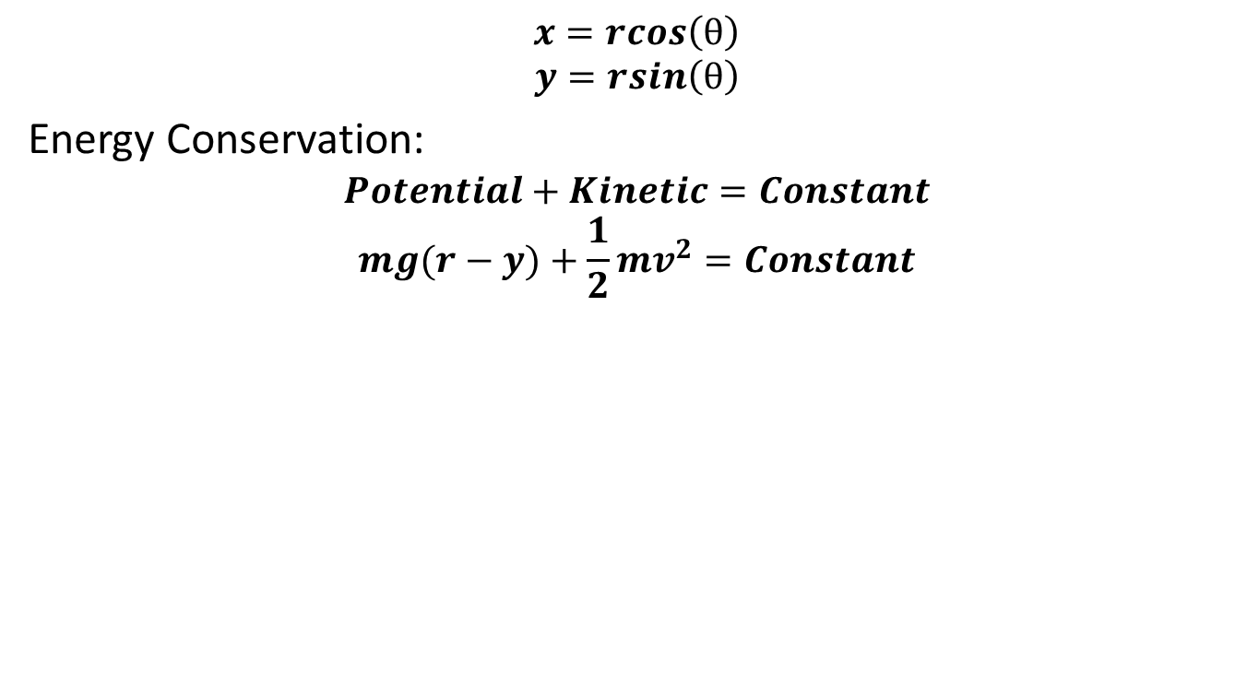
Pendulum Oscillating Motion
$$x=rcos\left(θ\right)$$
$$y=rsin\left(θ\right)$$
Energy Conservation:
$$Potential+Kinetic=Constant$$
$$mg(r−y)+\frac{1}{2}mv^{2}=Constant$$
0
x
θ
r
(x, y)
y

Slide 11
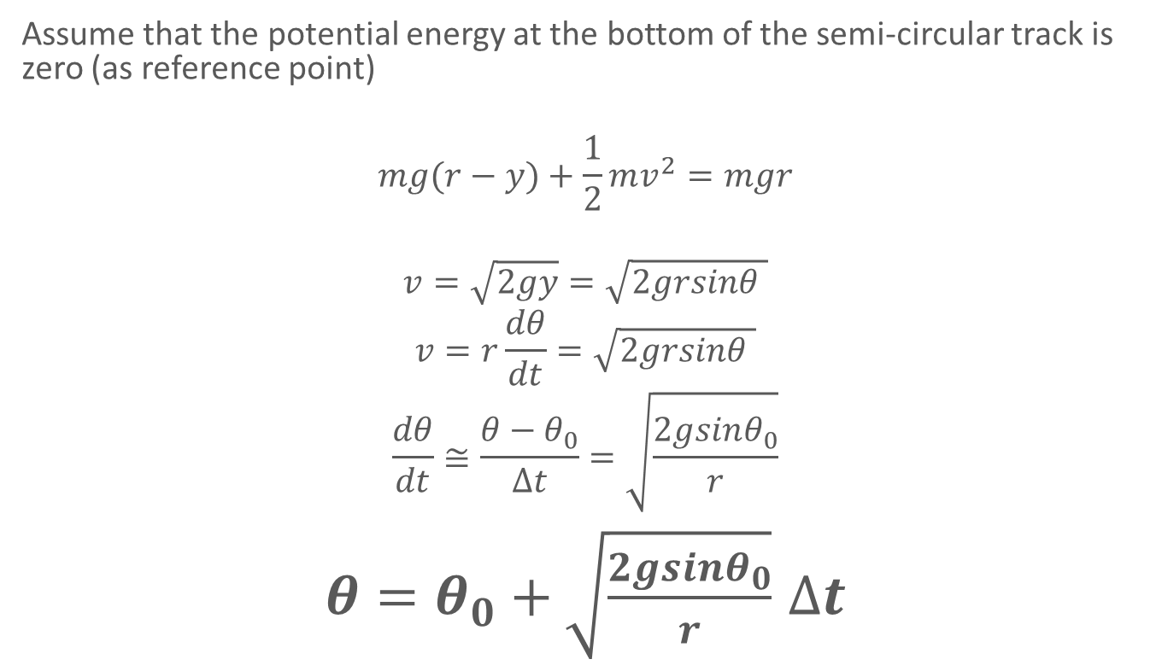
Pendulum Oscillating Motion
Assume that the potential energy at the bottom of the semi-circular track is zero (as reference point)
$$mg(r−y)+\frac{1}{2}mv^{2}=mgr$$
$$v=\sqrt{2gy}=\sqrt{2grsinθ }$$
$$v=r\frac{dθ}{dt}=\sqrt{2grsinθ }$$
$$\frac{dθ}{dt}≅\frac{θ−θ_{0}}{∆t}=\sqrt{\frac{2gsinθ_{0}}{r}}$$
$θ=θ_{0}+\sqrt{\frac{2gsinθ_{0}}{r}}$ $∆t$

Slide 12
Collision :
A perfectly elastic collision is defined as one in which there is no loss of kinetic energy in the collision.
inelastic collision is one in which part of the kinetic energy is changed to some other form of energy in the collision.
Conservation Of Momentum
For a collision occurring between object 1 and object 2 in an isolated system, the total momentum of the two objects before the collision is equal to the total momentum of the two objects after the collision. That is, the momentum lost by object 1 is equal to the momentum gained by object 2.

Slide 13
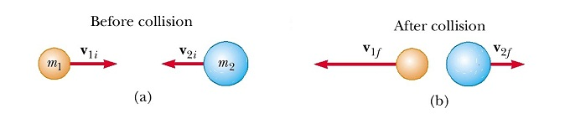
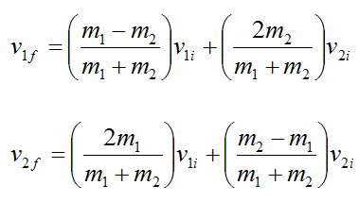
Elastic Collision
Momentum and Kinetic Energy Conservation
Source: real-world-physics-problem.com

Slide 14
Conclusion And Future Work :

